Slide 1
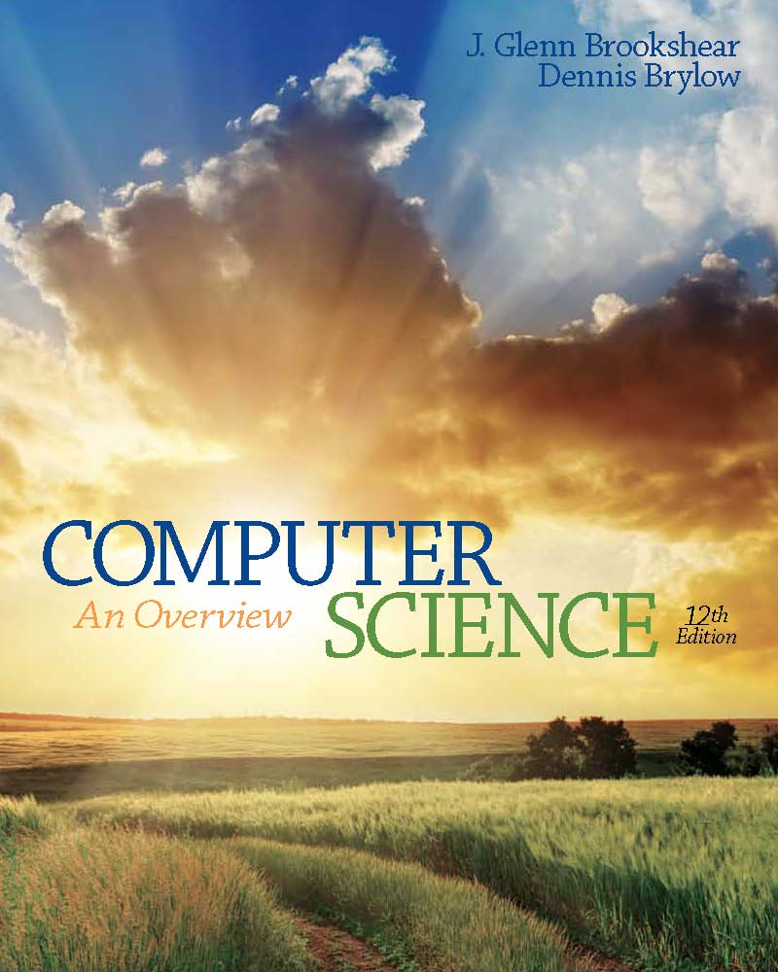
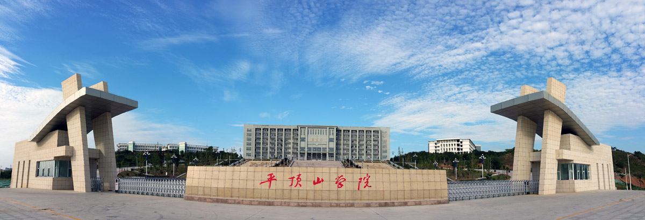
Computer Science: An Overview
Twelfth Edition
Chapter 3
Operating Systems
Yu Yang
School of Computer Science,
Pingdingshan University,
yangyu@pdsu.edu.cn
Notes:
If this PowerPoint presentation contains mathematical equations, you may need to check that your computer has the following installed:
1) MathType Plugin
2) Math Player (free versions available)
3) NVDA Reader (free versions available)

Slide 2
Learning Objectives
3.1 The History of Operating Systems
3.2 Operating System Architecture
3.3 Coordinating the Machine’s Activities
3.4 Handling Competition Among Processes
3.5 Security

Slide 3
Functions of Operating Systems
Oversee operation of computer
Store and retrieve files
Schedule programs for execution
Coordinate the execution of programs

Slide 4
Evolution of Shared Computing
Batch processing
Interactive processing
Requires real-time processing
Time-sharing/Multitasking
Implemented by Multiprogramming
Multiprocessor machines

Slide 5
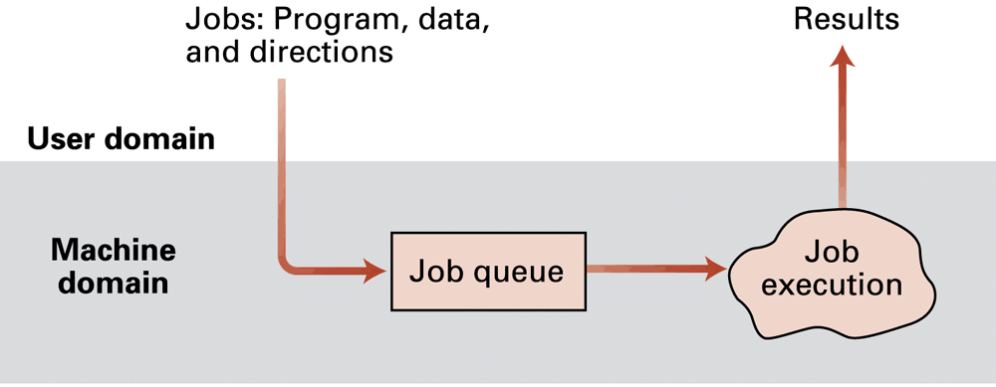
Figure 3.1 Batch processing

Slide 6
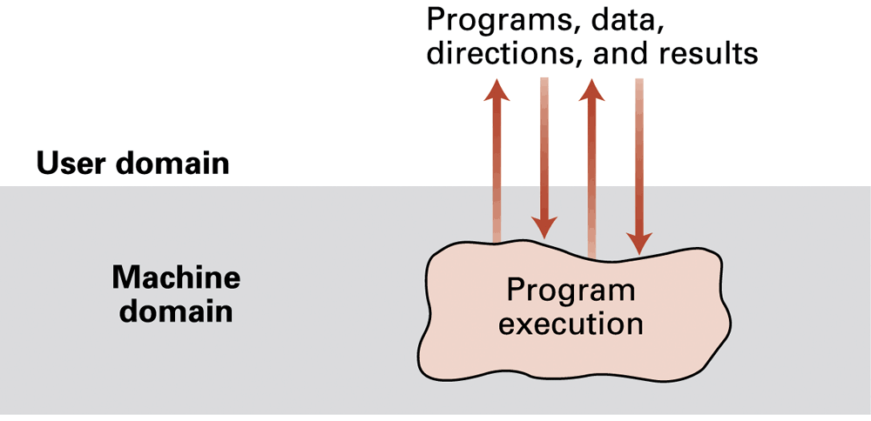
Figure 3.2 Interactive processing

Slide 7
Types of Software
Application software
Performs specific tasks for users
System software
Provides infrastructure for application software
Consists of operating system and utility software

Slide 8
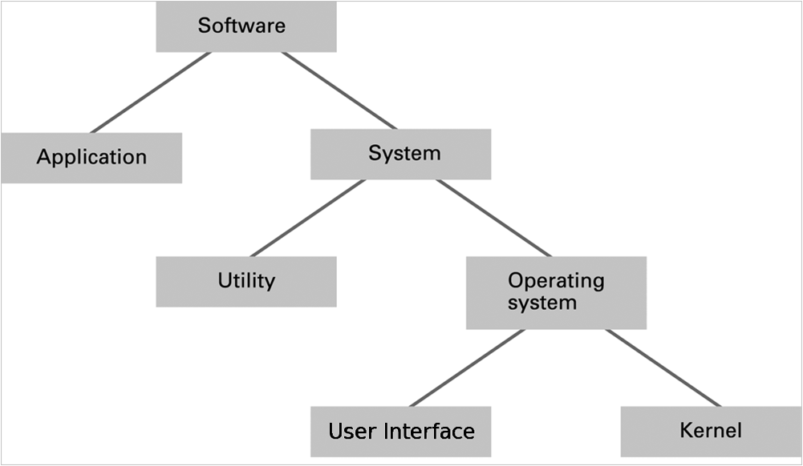
Figure 3.3 Software classification

Slide 9
Operating System Components
User Interface: Communicates with users
Text based (S h e l l)
Graphical user interface (G U I)
Kernel: Performs basic required functions
File manager
Device drivers
Memory manager
Scheduler and dispatcher

Slide 10
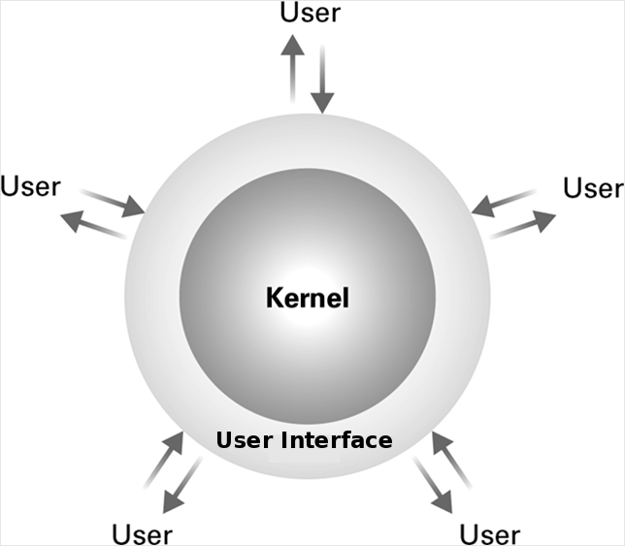
Figure 3.4 The User Interface Act as an Intermediary Between Users and the Operating System Kernel

Slide 11
File Manager
Directory (or Folder): A user-created bundle of files and other directories (subdirectories)
Directory Path: A sequence of directories within directories

Slide 12
Memory Manager
Allocates space in main memory
May create the illusion that the machine has more memory than it actually does (virtual memory) by playing a “shell game” in which blocks of data (pages) are shifted back and forth between main memory and mass storage

Slide 13
Getting it Started (Bootstrapping)
Boot loader: Program in R O M (example of firmware)
Run by the C P U when power is turned on
Transfers operating system from mass storage to main memory
Executes jump to operating system

Slide 14
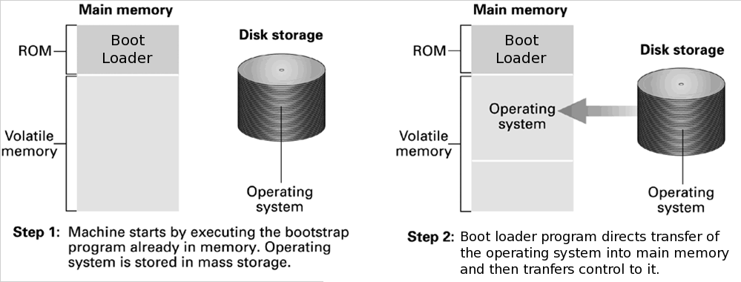
Figure 3.5 The booting process

Slide 15
Processes
Process: The activity of executing a program
Process State: Current status of the activity
Program counter
General purpose registers
Related portion of main memory

Slide 16
Process Administration
Scheduler: Adds new processes to the process table and removes completed processes from the process table
Dispatcher: Controls the allocation of time slices to the processes in the process table
The end of a time slice is signaled by an interrupt.

Slide 17
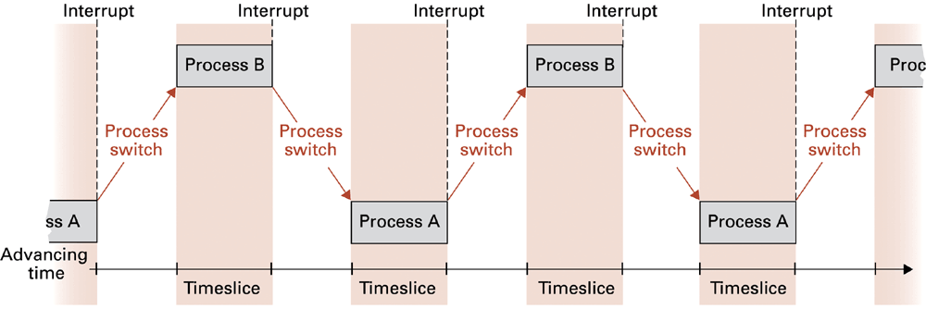
Figure 3.6 Time-sharing between process A and process B

Slide 18
Handling Competition for Resources
Semaphore: A “control flag”
Critical Region: A group of instructions that should be executed by only one process at a time
Mutual exclusion: Requirement for proper implementation of a critical region

Slide 19
Deadlock
Processes block each other from continuing
Conditions required for deadlock
1. Competition for non-sharable resources
2. Resources requested on a partial basis
3. An allocated resource can not be forcibly retrieved

Slide 20
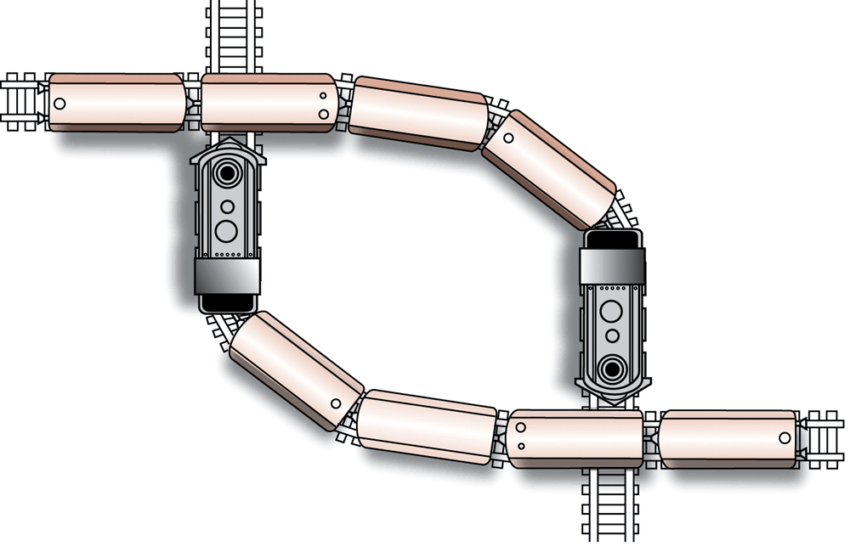
Figure 3.7 A Deadlock Resulting From Competition for Nonshareable Railroad Intersections

Slide 21
Security (1 of 2)
Attacks from outside
Problems
Insecure passwords
Sniffing software
Counter measures
Auditing software

Slide 22
Security (2 of 2)
Attacks from within
Problem: Unruly processes
Counter measures: Control process activities via privileged modes and privileged instructions

